Slide 1
OBEaaS Outcome Based Education as a Service
Group Members:
Aqib mukhtar se-056
Abdul rehman se-050
Muhammad uzair se-052
Internal supervisor:
Miss asma khan
Industrial advisor:
Dr. Farrukh arif
Software engineering department
Neduet, karachi

Slide 2
Contents
Abstract
Aims and objectives
Targeted customers
Project Output
Hardware Requirements
Software Requirements
Milestones
Work division and Gantt chart

Slide 3
Abstract
Baloch lkhe ga

Slide 4
Aims and Objectives
Baloch

Slide 5
Targeted Users
Teachers
Students
By using OBEaaS the teachers can do the following activities:
Define new CLOs, also can edit already existing CLOs
Define new assessment tools for a particular CLO
Map CLOs on a particular PLO
Generate a report of the academic record of the students
The student will get the following benefit:
Check the assessment methods
Check the marks of every course
Check the marks of each CLOs of a particular course
Check the overall progress in a semester

Slide 6
Project Output
The final output of the system is a microservice,
that will provide services of OBE to the existing web portal.
If the integration is not required, then OBE services will be
integrated to GUI, outputting a monolithic web portal.

Slide 7
Hardware Requirements
Only a single server machine is required inside NEDs premises,
connected to LAN. Rest of the network Infrastructure is already present and will be utilized as is. The estimates for servers resource consumptions will be made during design phase

Slide 8
Software Requirements
Development | Post development | Deployment
Visual Studio Code | Wireshark | Windows/Linux Server OS
Git and GitHub | Kali Linux | Open SSL
NodeJS with NPM | Penetration Testing Tools | MySQL
MySQL with Workbench | Volatility Framework | NodeJS
Windows/Linux PC OS | Miscellaneous as per need | Security and Reporting Tools
Open SSL
Web Browser
Miscellaneous as per need

Slide 9
Milestones

Slide 10
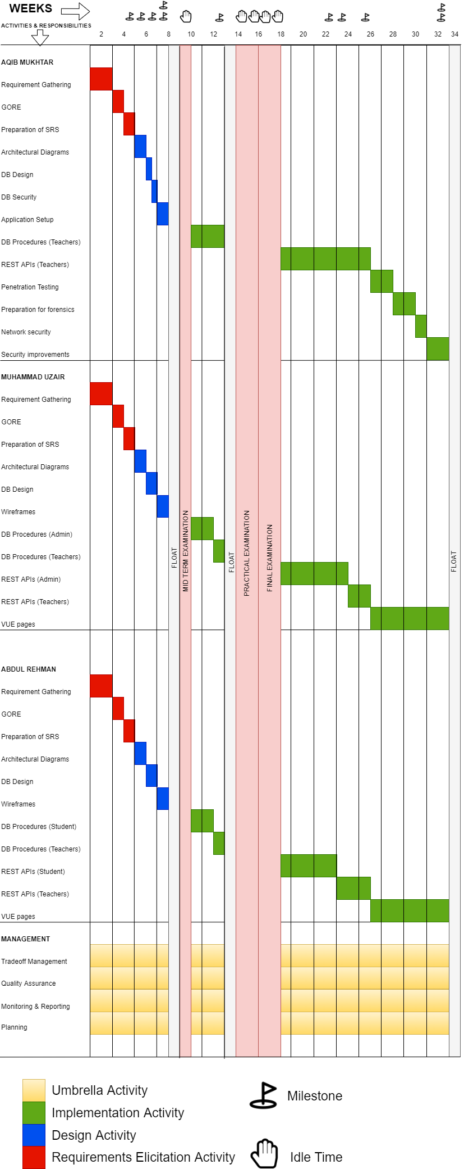
Gantt Chart

Slide 11
Thank You

